Slide 1
Single-cell RNA-seq analysis for cell type deconvolution
By Gopalakrishnan Kumar, MTech IIT-Bombay,
Consultant Data Scientist
LinkedIn: Profile Link : https://www.linkedin.com/in/gopalakrishnankumar-a73301110/
Github:https://github.com/Gopal21236/
Kaggle URL- https://www.kaggle.com/gopalkk2

Slide 2
Google Colab URL
https://colab.research.google.com/drive/12cJihdmka8skAG9_XkP09VRf3l6eeWf2?usp=sharing

Slide 3
Introduction
Single-cell RNA sequencing (scRNA-seq) enables transcriptomic profiling at the individual cell level, allowing researchers to investigate cellular heterogeneity, identify distinct cell populations, and study gene expression dynamics. Quality control (QC) is a critical step in scRNA-seq analysis to ensure that downstream analyses are performed on high-quality cells.

Slide 4
Introduction
In this analysis, the dataset was loaded as an AnnData object and quality control metrics were examined. The metadata available in the dataset included:
n_genes_by_counts
log1p_n_genes_by_counts
total_counts
log1p_total_counts
pct_counts_in_top_50_genes
pct_counts_in_top_100_genes
pct_counts_in_top_200_genes
pct_counts_in_top_500_genes
expr_group
Since cell-type annotations were unavailable, cells were grouped using expression-based quality metrics. Additional categorical variables were generated from gene counts and total counts to facilitate exploratory visualization.

Slide 5
Objective
The objective of this analysis was to investigate the relationship between cellular expression levels, detected gene counts, and sequencing depth using a combined stacked bar chart.
Specifically, the analysis aimed to:
Categorize cells according to overall expression levels.
Classify cells based on detected gene counts.
Classify cells based on total sequencing counts.
Visualize the distribution of these categories across expression groups.

Slide 6
Methodology
Expression Group Classification
Cells were assigned to expression groups based on overall expression levels:
Low Expression
Medium Expression
High Expression
These categories were stored in the variable:
expr_group

Slide 7
Methodology
Gene Count Categorization
Cells were divided into three equal quantile-based groups according to the number of detected genes:
Low_Genes
Medium_Genes
High_Genes
The categorization was performed using pandas qcut().

Slide 8
Methodology
Total Count Categorization
Similarly, cells were grouped according to sequencing depth (total UMI counts):
Low_Counts
Medium_Counts
High_Counts
This approach ensured balanced category sizes and facilitated comparative analysis.

Slide 9
Methodology
Two contingency tables were generated:
Expression Group × Gene Category
Expression Group × Count Category
The tables were merged and visualized using a stacked bar chart. Each bar represented an expression group, while the stacked segments represented the distribution of cells across gene-count and sequencing-depth categories.

Slide 10
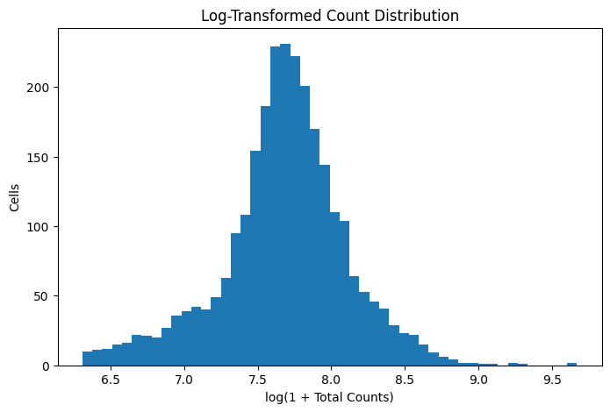
Data Visualization

Slide 11
Histogram Plot
Cells were grouped into:
Low Expression
Medium Expression
High Expression
These categories summarize the overall transcriptional activity of each cell.
Higher expression groups generally correspond to:
Higher RNA content
Increased biological activity
Greater transcript diversity

Slide 12
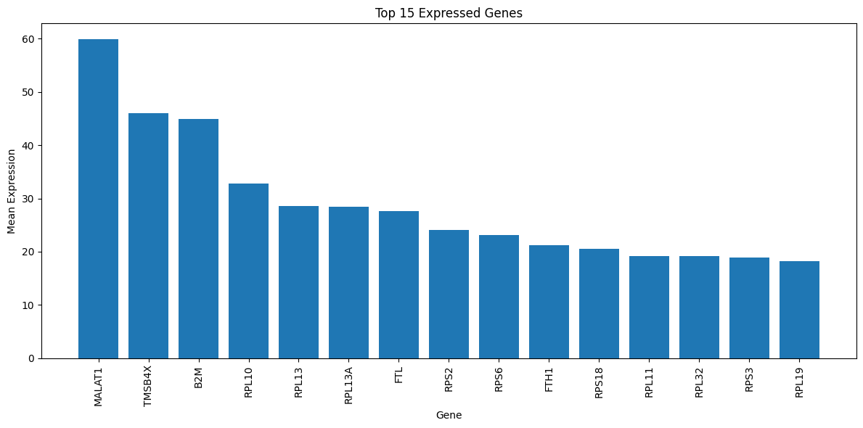
Data Visualization

Slide 13
Bar Chart Plot
The variable n_genes_by_counts was divided into three quantile-based categories:
Low_Genes
Medium_Genes
High_Genes
Quantile categorization ensures approximately equal numbers of cells in each category while facilitating comparative visualization.

Slide 14
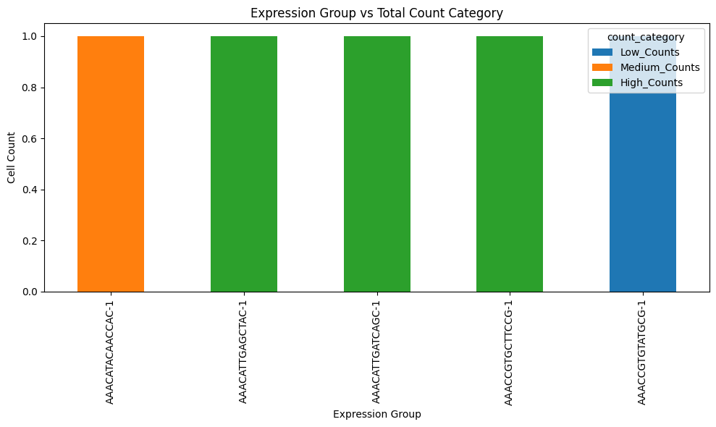

Slide 15
Stacked Bar Plot
Similarly, total_counts was divided into:
Low_Counts
Medium_Counts
High_Counts
These categories represent different sequencing-depth levels.

Slide 16
Data Visualization

Slide 17
Combined Stacked Bart Plot
Two contingency tables were generated:
Expression Group × Gene Category
Expression Group × Count Category
Both tables were merged into a single visualization.
Each stacked bar represents an expression group.
Each colored segment corresponds to one of the gene-count or sequencing-depth categories.
This visualization simultaneously summarizes multiple QC metrics.

Slide 18
Key Insights
Expression Level Positively Correlates with Gene Detection
The combined stacked bar chart indicates that cells classified within the High Expression group generally contain a larger proportion of High_Genes cells. This suggests that increased transcriptional activity is associated with a greater number of detected genes, reflecting higher transcriptomic complexity.
Sequencing Depth Influences Cellular Complexity
Cells with higher total_counts are more frequently observed within the High Expression category. Greater sequencing depth increases the probability of detecting low-abundance transcripts, resulting in improved gene coverage and more comprehensive expression profiles.

Slide 19
Key Insights
Low Expression Cells May Represent Lower-Quality Observations
Cells belonging to the Low Expression group are often associated with Low_Genes and Low_Counts categories. These cells may correspond to damaged cells, empty droplets, low RNA-content cells, or technical artifacts. Such observations should be carefully evaluated during quality-control filtering.

Slide 20
Key Insights
Gene Count and Total Count Show Consistent Trends
The distribution of gene categories and count categories across expression groups demonstrates a consistent positive relationship. Cells with higher sequencing depth typically exhibit higher gene detection, confirming the expected dependence between sequencing coverage and transcript recovery.

Slide 21
Key Insights
Quality-Control Metrics Are Internally Consistent
The agreement among expression level, detected genes, and total counts suggests that the dataset exhibits internally consistent quality-control characteristics. These metrics collectively provide confidence that the majority of cells follow expected biological and technical patterns.
Cellular Heterogeneity Is Evident
The presence of distinct Low, Medium, and High expression groups demonstrates considerable heterogeneity within the dataset. Such variability is characteristic of scRNA-seq experiments and indicates that the dataset contains cells with differing transcriptional activities and molecular complexities.

Slide 22
Key Insights
Combined Visualization Improves Data Interpretation
Integrating gene-count categories and sequencing-depth categories into a single stacked bar chart enables simultaneous comparison of multiple quality-control metrics. This approach provides a clearer overview than analyzing each metric independently and helps identify broad trends across expression groups.

Slide 23
Key Insights
Current Analysis Represents Exploratory Quality Assessment
Because the dataset does not contain annotated cell-type labels, the present analysis should be interpreted as an exploratory quality-control assessment rather than a biological comparison of cell populations. Biological conclusions regarding specific cell types cannot yet be drawn.
Dataset Appears Suitable for Downstream Analysis
The observed relationships among expression level, gene detection, and sequencing depth indicate that the dataset is appropriate for subsequent preprocessing and analysis. Following standard quality-control filtering, the data can be used for normalization, dimensionality reduction, clustering, and marker-gene identification.

Slide 24
Key Insights
Future Analyses Will Enhance Biological Interpretation
To obtain biologically meaningful insights, the dataset should undergo additional analyses, including highly variable gene selection, Principal Component Analysis (PCA), neighborhood graph construction, Leiden clustering, UMAP visualization, marker gene detection, automated cell-type annotation, differential expression analysis, pathway enrichment, and cell-type deconvolution using reference datasets.

Slide 25
Discussion
Although no biological cell-type labels were available, the QC analysis provides valuable insight into dataset quality.
The absence of cell-type annotations prevents biological interpretation of individual cell populations.
However, the QC metrics strongly suggest that expression level, detected genes, and sequencing depth are positively associated.
These observations justify proceeding with downstream analyses such as normalization, dimensionality reduction, clustering, and annotation.

Slide 26
Limitations
Several limitations should be acknowledged.
No cell-type annotations were available.
Clustering analysis was not performed.
Marker-gene analysis was unavailable.
QC categories were generated statistically rather than biologically.
Doublet detection and mitochondrial RNA filtering were not included.
Batch effects were not assessed.

Slide 27
Conclusion
This exploratory quality-control analysis demonstrates the utility of combined stacked bar charts for summarizing multiple scRNA-seq quality metrics. The visualization highlights the association between expression level, detected gene counts, and sequencing depth, providing a concise overview of cellular heterogeneity and sequencing quality. Although biological interpretation is limited by the absence of cell-type annotations, the dataset appears suitable for advanced downstream analyses after appropriate preprocessing. Subsequent steps such as normalization, clustering, marker-gene detection, and cell-type annotation will enable a deeper understanding of the biological composition of the dataset and support robust cell-type deconvolution and comparative transcriptomic analyses.

